Slide 1
1ST MEETING OF THE PUBLIC SAFETY INFORMATION FORUM (PSIF) – FY 2026/27
Loyiso Tyabashe
Group Chief Executive Officer
20 June 2026

Slide 2
PSIF AGENDA – 20 June 2026
 | ITEM | LEAD | TIME
1. | Welcome and Attendance | Thabiso Malatsi, Chairperson | 11:15 – 10:20
2. | Safety Minute | Mologadi Kekana, General Manager: Compliance Services | 11:20 – 11:30
3. | Minutes of the previous meeting | Thabiso Malatsi, Chairperson | 11:30 – 11:40
4. | Matters arising from previous minutes | Thabiso Malatsi, Chairperson | 11:40 – 11:45
5. | Necsa Group Update | Loyiso Tyabashe, GCEO | 11:45 – 12:20
 | Comments and Discussion | Thabiso Malatsi, Chairperson | 12:20 – 12:30
6. | NNR Update | Sello Mosoeunyane, NNR Representative | 12:30 – 12:40
 | Comments and Discussion | Thabiso Malatsi, Chairperson | 12:40 – 12:50
7. | General | Thabiso Malatsi, Chairperson | 12:50 – 13:00
8. | Closure | Thabiso Malatsi, Chairperson | 13:00

Slide 3
LEGISLATIVE REQUIREMENTS FOR PUBLIC SAFETY INFORMATION FORUM MEETINGS
  Necsa, as the holder of a nuclear installation license, holds Public Safety Information Forum to inform people living in the area that falls under the scope of the emergency plan on nuclear safety and radiation safety matters related to its activities.
  Necsa’s licensing requirements guide us in terms of key areas where we need to account to communities about the impacts of our business.
  Relevant stakeholders are invited to an open meeting on a quarterly basis.
  Nuclear Energy Act (NEA; Act No. 46 of 1999)
  Environmental compliance Acts
  Occupational Health and Safety Act
  National Nuclear Regulator Amendment Act 26 of 24
  Disaster Management Act
  Mission: To develop and safely utilise nuclear, radiation, and related technologies to make a socioeconomic impact in diverse global markets through commercial and non-commercial technologies, in an environmentally responsible manner.
  PSIF meetings demonstrates a Necsa that lives up to its values that include “Safety First”.

Slide 4
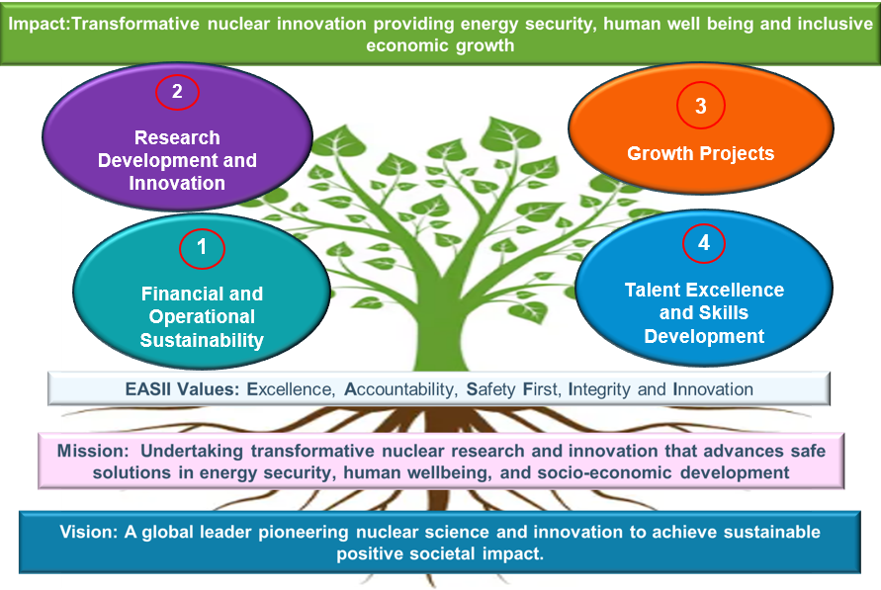
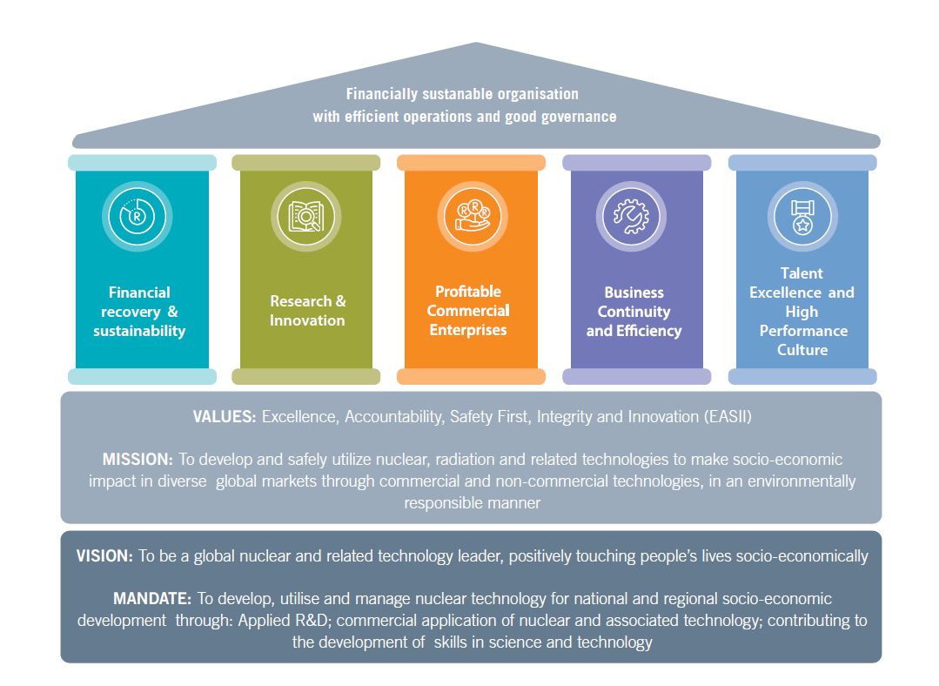

DELIVERY ON OUR CORPORATE STRATEGY
KEY PERFORMANCE AREAS
1. Financial and Operational Sustainability
2. Research Development & Innovation
3. Growth Projects
4. Talent Excellence and Skills Development
CALL TO EXECUTION
To develop and avail nuclear technology and related products & services for stakeholder value

Slide 5
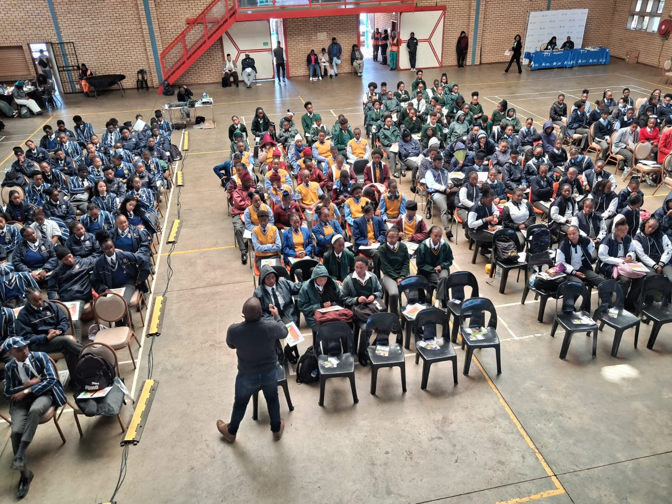
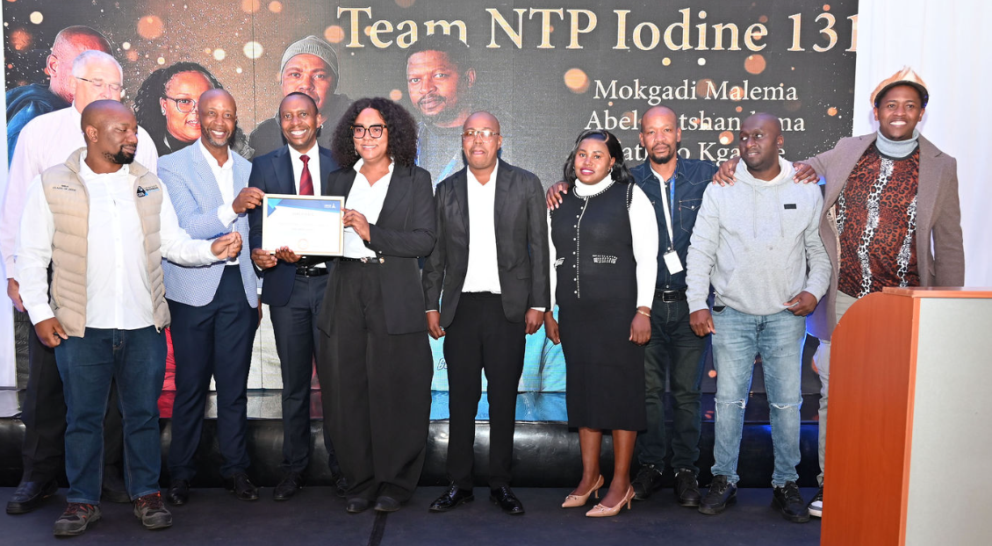
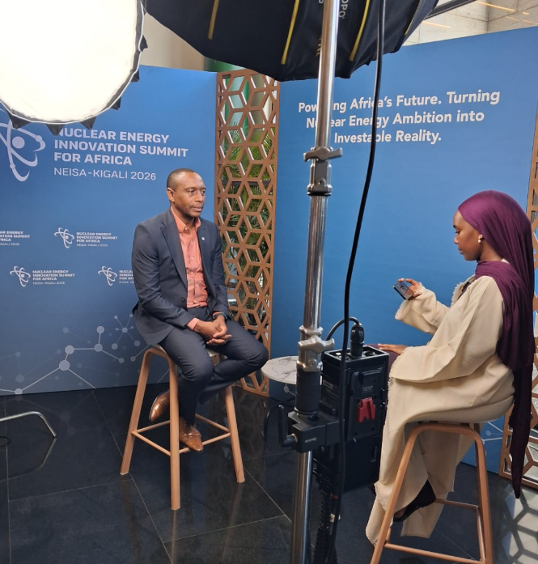
BUSINESS UPDATE
Necsa Group Excellence and Recognition Awards, 28 May 2026
Necsa at NNR Outreach to Mogale City
15 May 2026
Necsa GCEO at NEISA26 in Kigali, Rwanda 19 - 21 May 2026
Notes:
This was a 67 minutes community service initiative, inspired by Nelson Mandela. A collaborative effort between the Department of Electricity and Energy, Necsa, HUAWEI and AVON/Dedisa.
Schools of beneficiation were Hofmeyr High School, Edward Phatudi Secondary School, Bokgoni Technical School and Seaparankwe Primary School.

Slide 6
REGULATORY UPDATE
NNR (41 NILs)
03
04
05
06
07
08
09
10
11
12
13
14
15
16
17
18
19
20
21
22
23
24
25
26
27
28
29
30
31
32
33
34
35
36
37
38
39
40
41
02
42
NNR LICENSES
All licences that are authorised by the NNR remain valid
KEY PROJECTS UPDATE
Ageing management of SAFARI-1 is progressing well with the IAEA SALTO mission having been conducted from 2-6 February 2026.
The process of applying for the long term operation of SAFARI-1 beyond it’s current license limit date of December 2030 has started. The NNR has responded with minimal comments on our initial licensing document outlining the licensing approach.
The extension of Thabana Pipe Store is on track, the approval for hot commissioning was received in May 2026. Hot commissioning activities are underway and continuing withing the approved parameters.
Cat. | Seriousness
Cat. 0 | Near Miss | Event that could result in negligible SHE / Security consequences
Cat. 1 | Minor | Event that could result in minor SHE / Security consequences
Cat. 2 | Moderate | Event that could result in moderate SHE / Security consequences
Cat. 3 | Significant | Event that could result in significant SHE / Security consequences
Cat. 4 | Serious | Event that could result in serious SHE / Security consequences
The Category 3 events were related to non adherence to timelines related to identified finding resulting in upgrading of the category

Slide 7
ENVIRONMENTAL MONITORING
RADIOLOGICAL RELEASES | Gaseous releases | NTP stacks (4) SAFARI -1 stack (1) Inconsequential stacks (29) | NNR compliance (0.05 mSv) | 0.00023 mSv (Jan – March 2026)
 | Effluent Release | Effluent release to the Crocodile River | NNR compliance (0.15 mSv) | 0.00018 mSv (Jan – March 2026)
WATER PERMIT | Effluent Release | Effluent release to the Crocodile River | DWS compliance (250 000 m³) per water year | 39 065 m³ (Oct 2025- March 2026)
AIR EMMISION LICENCE | Gaseous releases | Acids Production - Hydrogen Fluoride [HF] - Area V-60 Salts Production – Sodium Silica Fluoride [Na₂SiF₆] - Area V-69 Fluorine Generation – [F2] - B-H1 Surface Fluorination Production Plant - B-E3/4 Fluor Organics Production - Potassium Propanoate. [perfluoro 23- methoxypropyl] - B-C2 | Pelchem AEL licence BPDM/AEL/OCTOBER2020 Annual Air Allowable Emissions (Kg/a) @ 5mg/m³ = 17 695 kg | 63 Kg F (Jan – March 2026)
All environmental monitoring results are significantly below regulatory limits

Slide 8
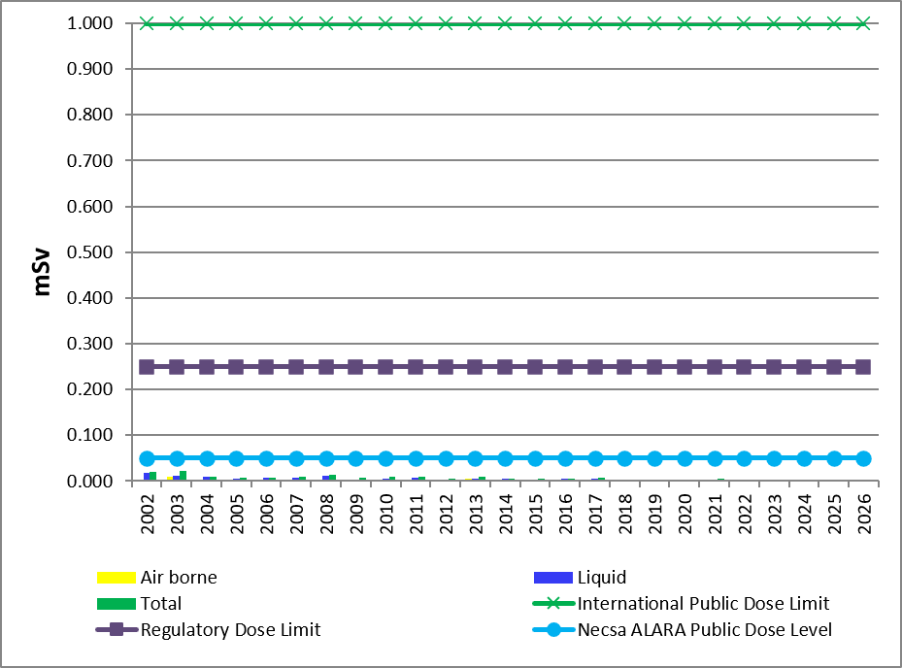
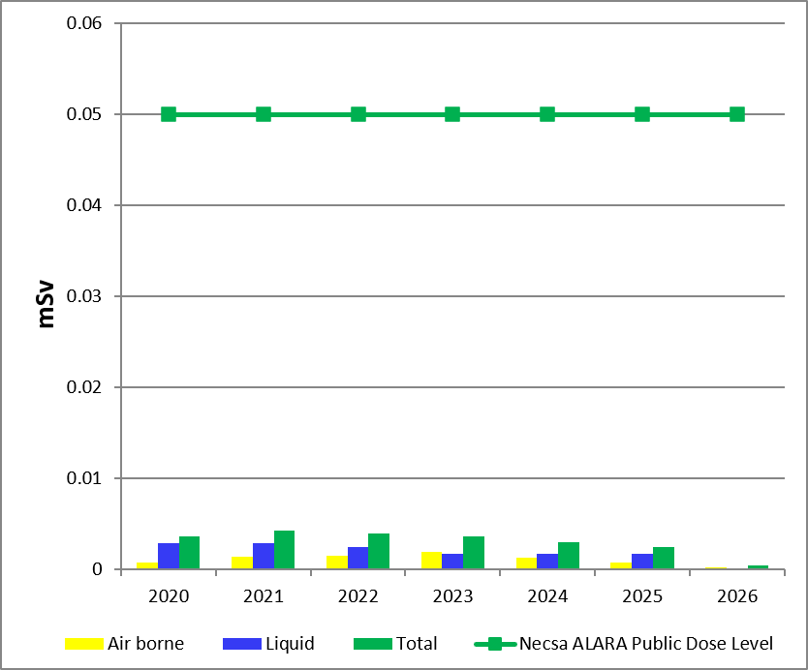
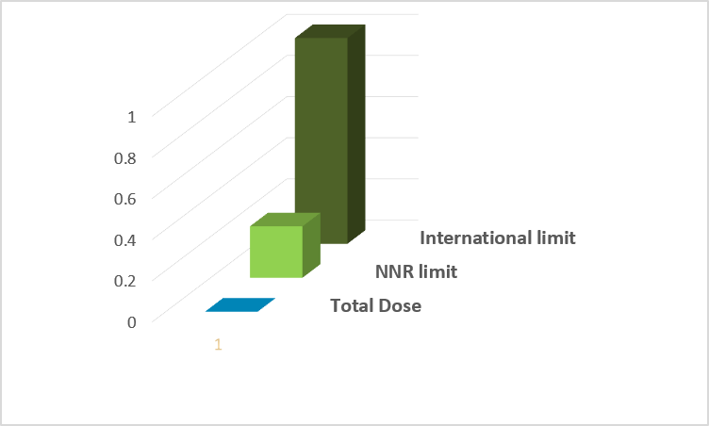
PUBLIC DOSE
 |  | Total Dose Jan – March 2026 | Necsa ALARA Level | Regulatory dose limit | International limit
Public dose | (January – March) 2026 | 0,00041 mSv | 0,05 | 0,250 mSv | 1mSv
The public dose for the 1st quarter 2026 (January to March) due to radioactive discharges to the atmosphere was 0.00023 mSv and the public dose due to radioactive effluent released to the Crocodile River was 0.00018 mSv.
The cumulative public dose (January to March) 2026 was 0,00041 mSv that is 0.16 % of the regulatory dose limit of 0,250 mSv.
These results show that the dose impact to the public is low relative to the regulatory dose limit.

Slide 9

EMERGENCY PREPAREDNESS
Unusual Event
An abnormal event that indicates an unplanned deviation from normal operation, the consequences of which require partial activation of the emergency plan.
Alert
A situation that could develop into a Site or General Emergency and therefore requires notification of all emergency functionaries (internal and external) in order to obtain a state of readiness to respond.
Site Emergency
An emergency condition that poses a serious hazard on-site but poses no serious hazard to the public off-site.
General Emergency
An emergency condition that poses or potentially poses a serious hazard off-site requiring full implementation of the EP.
Emergency exercises are performed on a routine basis to ensure readiness of all functionaries
Members of the public are informed appropriately during emergency exercises
Partnerships with local authorities ensure that information reaches people in time
Since the last PSIF there has been no emergency activated at Necsa
7 May
Chemical Exercise
14 August
Radiological Exercise
20 November
Chemical Exercise
Jan 26
Feb 26
Mar
26
Apr 26
May 26
Jun 26
Jul
26
Aug
26
Sep
26
Oct 26
Nov 26
Dec 26
06 March
Radiological Exercise
19 June
Security Exercise
09 October
Radiological Exercise

Slide 10
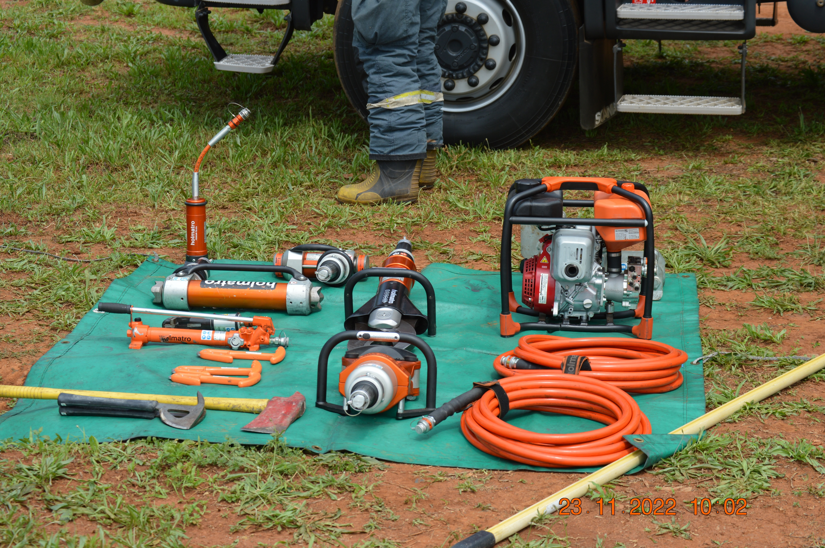
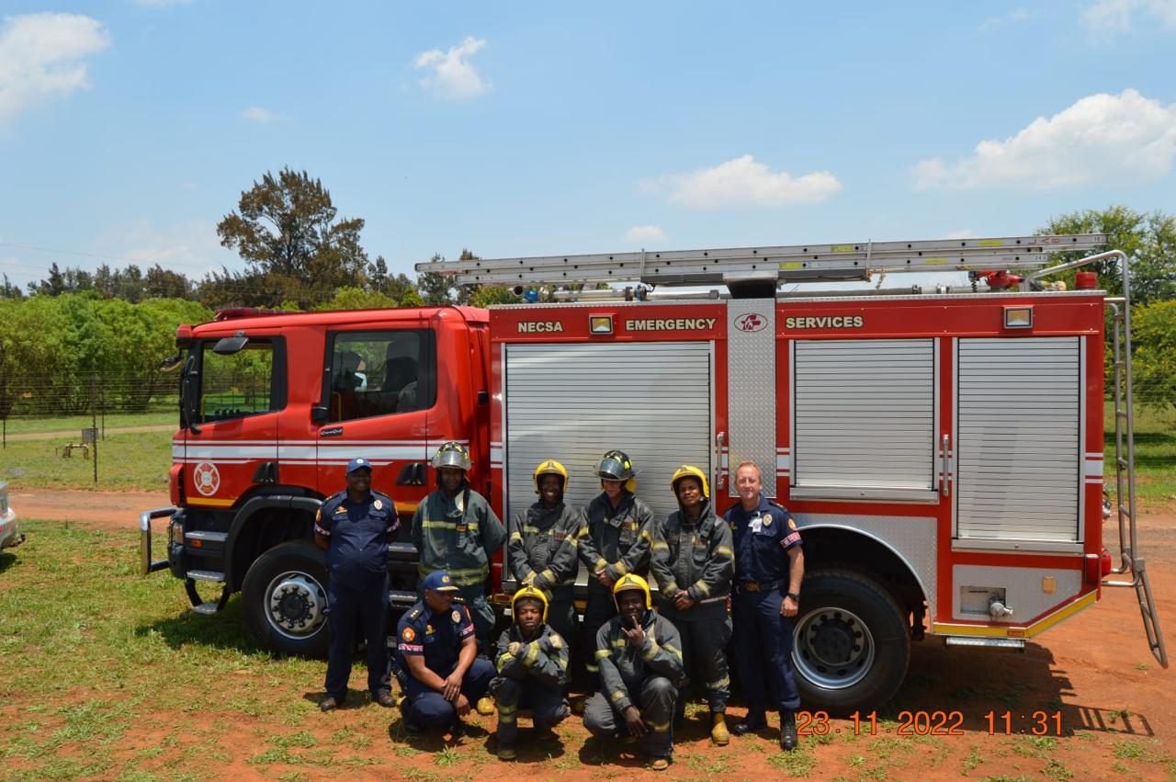
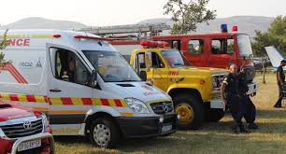
SERVICES TO SURROUNDING COMMUNITIES
February 2026 – May 2026
Vehicle Accidents
Number of vehicles accidents | 5
Number of patients Transported | 2
Animal related vehicle accidents | 0
Fire Calls
Number of fire of calls | 5
Number of patients transported | 0
Ambulance Calls
Number of ambulance calls | 14
Number of patients transported | 5
Debriefing at the End of the Exercise
Response Fleet
Decontamination Showers

Slide 11
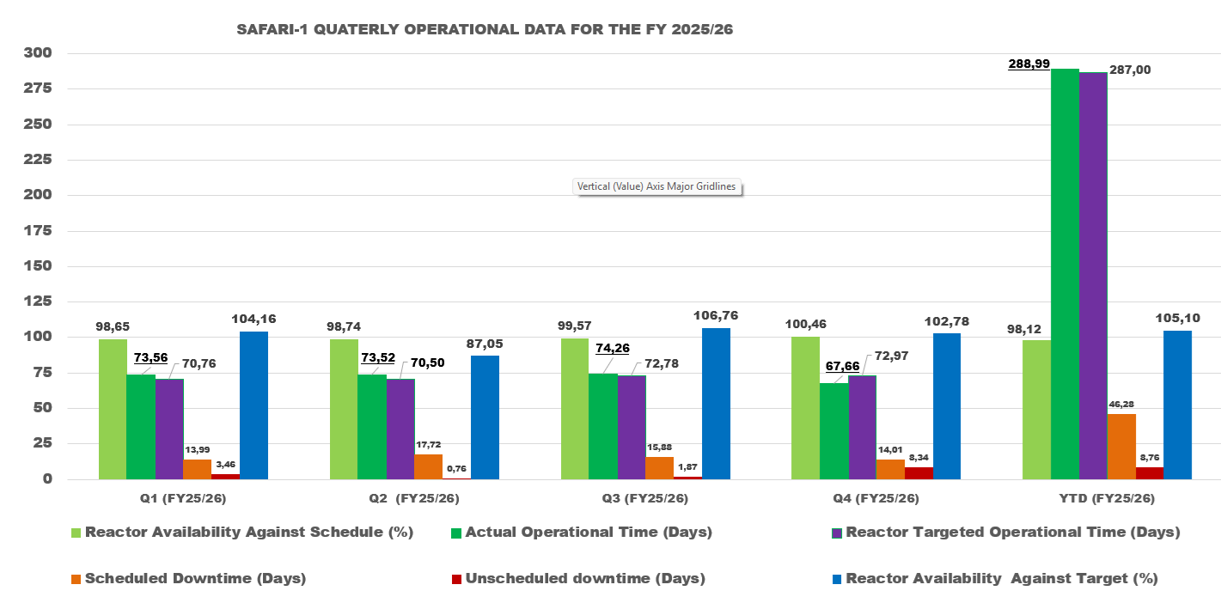

SAFARI-1 OPERATIONAL PERFORMANCE
Q4 ( JAN-MAR 2026)
1. SAFARI-1 operational performance:
  67.66 days against targeted availability of 72.97 days,
  YTD target 287.00 days actual END Q4 YTD performance is 288.99 days, which translate to 102.78% availability against target.
2. Downtime Events experienced in Q4:
  The reactor experienced four (4) downtime events during Q4,
  None of these had safety implication for the reactor
  SAFARI-1 continues to be a centre of scientific research and technology development and learning that Necsa shares with a wide variety of stakeholders

Slide 12
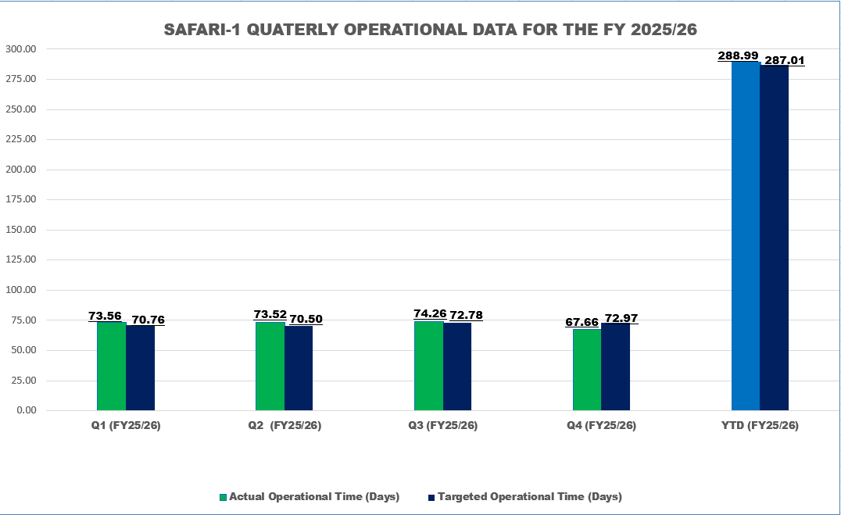
SAFARI-1 OPERATIONAL PERFORMANCE
Q4 and YTD performance achieved
  67.66 days against a targeted availability of 72.97 days
  YTD target 287 days and actual YTD performance is 288.99 days, which translate to 102.78% availability against target.
Downtime Events experienced in Q4:
  The reactor experienced four (4) downtime events during Q4,
  None of these had safety implication for the reactor
SAFARI-1 continues to be a centre of scientific research and technology development and learning that Necsa shares with a wide variety of stakeholders.

Slide 13
CONCLUSION
Necsa continues in ensuring safety, environmental stewardship, and emergency preparedness in its operation. This sets a good foundation for future nuclear-related projects.
We extend our sincere appreciation to all stakeholders, including community members, regulators, and partners, who contribute to the success of these forums.
Together, we will continue to build a safe, sustainable, and forward-looking nuclear and nuclear technology-related future.
Necsa remains steadfast in its commitment to safety, operational excellence, regulatory compliance, and transparent engagement with our surrounding communities.

